Slide 1
CSE332 INDUSTRY ETHICS AND LEGAL ISSUES
Lecture #0
The kick start session

Slide 2
Course Details
Course Code:- CSE332
LTP:- 2 0 0 [2 lectures/week]
Credits:- 2

Slide 3
Vision
To be a globally recognised school through excellence in teaching, learning and research for creating Computer Science professionals, leaders and entrepreneurs of future contributing to society and industry for sustainable growth.

Slide 4
Mission
To build computational skills through hands-on and practice-based learning with measurable outcomes.
To establish a strong connect with industry for in-demand technology driven curriculum.
To build the infrastructure for meaningful research around societal problems.
To nurture future leaders through research-infused education and lifelong learning.
To create smart and ethical professionals and entrepreneurs who are recognized globally

Slide 5
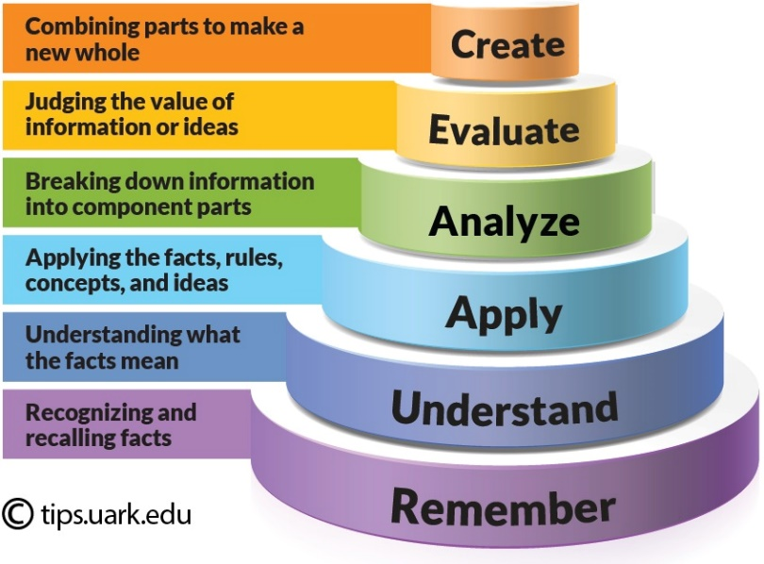
Revised Bloom’s Taxonomy
Bloom's Taxonomy is a framework for categorizing educational goals, It is widely used by educators to create learning objectives, assessments, and activities that encourage higher-order thinking. The taxonomy is typically represented as a hierarchical model with six levels:
Remembering: Recalling facts and basic concepts.
Example: Define, list, memorize, repeat, state.
Understanding: Explaining ideas or concepts.
Example: Describe, explain, interpret, summarize, classify.
Applying: Using information in new situations.
Example: Use, execute, implement, demonstrate, solve.
Analyzing: Breaking information into parts to explore understandings and relationships.
Example: Compare, contrast, examine, test, differentiate.
Evaluating: Justifying a decision or course of action.
Example: Critique, judge, argue, support, validate.
Creating: Producing new or original work.
Example: Design, construct, plan, produce, invent.

Slide 6
Course outcome
Through this course students should be able to:
CO1 :: Demonstrate Ethics across various professional domains
CO2 :: Apply the understanding of intellectual property concepts in practical contexts
CO3 :: Analyze the benefits available under startup India initiative

Slide 7
Course outcome
Through this course students should be able to:
CO4 :: Explain comprehensive business plan for an IT startup
CO5 :: Classify latest trends to contribute effectively to dynamic landscape of IT industry
CO6 :: : Examine various cyber laws to address emergency digital threats

Slide 8
Program Outcomes
PO1 Engineering knowledge: Apply the knowledge of mathematics, science, engineering fundamentals, and an engineering specialization to the solution of complex engineering problems.
PO2 Problem analysis::Identify, formulate, research literature, and analyze complex engineering problems reaching substantiated conclusions using first principles of mathematics, natural sciences, and engineering sciences.
PO3 Design/development of solutions::Design solutions for complex engineering problems and design system components or processes that meet the specified needs with appropriate consideration for the public health and safety, and the cultural, societal, and environmental considerations.
PO4 Conduct investigations of complex problems::Use research-based knowledge and research methods including design of experiments, analysis and interpretation of data, and synthesis of the information to provide valid conclusions.

Slide 9
Program Outcomes
PO5 Modern tool usage::Create, select, and apply appropriate techniques, resources, and modern engineering and IT tools including prediction and modeling to complex engineering activities with an understanding of the limitations.
PO6 The engineer and society::Apply reasoning informed by the contextual knowledge to assess societal, health, safety, legal and cultural issues and the consequent responsibilities relevant to the professional engineering practice.
PO7 Environment and sustainability::Understand the impact of the professional engineering solutions in societal and environmental contexts, and demonstrate the knowledge of, and need for sustainable development.
PO8 Ethics::Apply ethical principles and commit to professional ethics and responsibilities and norms of the engineering practice.
PO9 Individual and team work::Function effectively as an individual, and as a member or leader in diverse teams, and in multidisciplinary settings.

Slide 10
Program Outcomes
PO10 Communication::Communicate effectively on complex engineering activities with the engineering community and with society at large, such as, being able to comprehend and write effective reports and design documentation, make effective presentations, and give and receive clear instructions.
PO11 Project management and finance::Demonstrate knowledge and understanding of the engineering, management principles and apply the same to one’s own work, as a member or a leader in a team, manage projects efficiently in respective disciplines and multidisciplinary environments after consideration of economic and financial factors.
PO12 Life-long learning::Recognize the need for, and have the preparation and ability to engage in independent and life-long learning in the broadest context of technological change.

Slide 11
Program Specific Outcomes
PSO1: Apply acquired skills in software engineering, networking, security, databases, intelligent systems, cloud computing and operating systems to adapt and deploy innovative software solutions for diverse applications.
PSO2: Apply diverse IT skills to design, develop, and evaluate innovative solutions for business environments, considering risks, and utilizing interdisciplinary knowledge for efficient real-time projects benefiting society.

Slide 12
Skill Attainment
Logical Thinking
Technical Competence
Publication
Patent/ Copyright
Interpersonal Skills

Slide 13
Course Contents
Unit 1: ETHICS
Definition of ethics, Importance of integrity, Ethics in business world, improving corporate ethics, Creating an ethical work environment, Ethical decision making, Ethics in information technology, Ethical behavior of IT professional, Common ethical issues for IT users, Supporting the ethical practices of IT users
Unit 2: INTELLECTUAL PROPERTIES
Different kinds of marks (brand names, logos, signatures, symbols, well known marks, certification marks and service marks), Patents, Importance of Patent Information in Business Development, Concept of Intellectual Property, Copyrights, Trademarks
Unit 3: GOVERNMENT FUNDING AND SCHEMES FOR STARTUPS
what are Startups, Startup India benefits, Resources, bank loan for start up business, Start-up India, 10000 startups -A NASSCOM Initiative, Export promotion schemes: Software Technology Parks (STPs), Special Economic Zones (SEZ) Scheme, Laws for Startups

Slide 14
Course Contents
Unit 4: STARTUP IN IT
Planning of startup business in IT sector-Executive summary, General company Description, Products and services, Marketing plan, Operational plan, Management and organization, Personal Financial Statement, Startup Expenses and Capitalization, Financial Plan, Appendices, Refining the Plan, Examples of Successful Start-ups
Unit 5: COMPANIES
Introduction to IT and ITES industry (Product based, Services based), Introduction to NASSCOM, STPI, Overview on latest IT projects with global impact, Case study of an IT industry (Product based and Services based), Recent technology advancement, Current affairs related with the IT industry, Diversity in the Workforce
Unit 6: LEGAL, ETHICAL AND PROFESSIONAL ISSUES IN INFORMATION SECURITY
Introduction, Law and Ethics in Information Security, Organizational Liability and the Need for Counsel, Policy Versus Law, Cyber Crime, Cyber-crime on the rise, Cyber law of India, Need for cyber law in India

Slide 15
Course Assessment Model
Marks Breakup
Attendance 5
CA 25
MTE 20
ETE 50
Total 100

Slide 16
Details of Academic Tasks
AT1:Case Based Assignment (IPR) Lecture 06
(Before MTE)
AT2:Test2(MCQ based) Lecture 18
(After MTE)
Note: No MOOC Certification is Applicable

Slide 17
AT1 –IPR Rubrics
Identification of Problem Statement and formulation of Objectives- 15 Marks
Analysis of Existing Case Studies (Study of Literature) - 15 Marks
Originality and Innovation- 20 Marks
Use of Relevant Terminology (Problem Solution) - 15 Marks
Clarity and Organization (Documentation)- 20 Marks
Presentation Skills- 15 Marks
These marks will be prorated with the marks obtained by the student out of 30 marks.

Slide 18

Text Book/ Reference Book
Text Book
ETHICS 101
Author: JOHN .C MAXWELL
Publisher: Hachette India

Slide 19
Online Education Resources
Introduction to Intellectual Property - https://www.coursera.org/learn/introduction-intellectual-property.
Startup Entrepreneurship Specialization
https://www.djangoprojecthttps://www.coursera.org/specializations/startup-entrepreneurship.com/.

Slide 20

Unit-1: Ethics

Slide 21

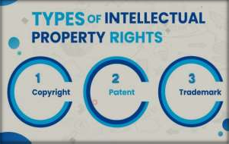
Unit-2: Intellectual Properties

Slide 22

Unit-3: Government Funding and Schemes for Startup

Slide 23

Unit-4: Startup in IT

Slide 24

Unit-5: Companies

Slide 25
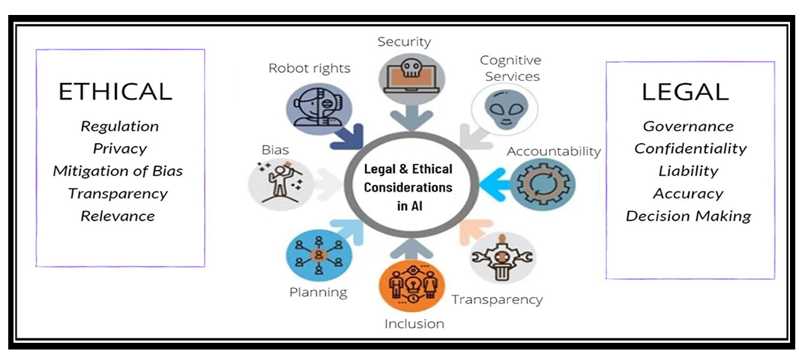
Unit-6: Legal, Ethical and Professional Issues in Information Security

Slide 26

Next Class: Ethics

